Slide 1

AAE 875 – Fundamentals of Object Oriented Programming and Data Analytics
Cornelia Ilin, PhD
Department of Ag & Applied Economics
UW-Madison
Week 6 - Summer 2019

Slide 2

Logistics – deadline extensions
zyLabs 11 – 13 are due tomorrow (8/8) at 11:59 pm
FinalProgram is due on Monday (8/12) at 11:59 pm

Slide 3
Logistics – final exam
Monday (8/12) between 10-12 pm
Location: CS 1370 lab
How to prepare: all material in zyBooks, Lectures, Labs (with Adam), guest speaker (Anton B.)
Level of difficulty?

Slide 4
GIS
What is GIS? Software
GIS with Python
The coordinate system
Geometric objects/ Spatial data
Geocoding

Slide 5
What is GIS?
A geographic information system (GIS) designed to capture, store, manipulate, analyze, manage, and present all types of geographical data
Data = spatial data (location on earth) + attribute data (additional information)
Schools example:
Spatial data = actual location of the schools
Attribute data = school name, level of education, student capacity etc.

Slide 6
GIS Software
Plenty of options…
At UW: ArcGIS, QGIS
More info here: https://researchguides.library.wisc.edu/c.php?g=178144&p=1169833

Slide 7
GIS with Python
Can do GIS-related tasks w/o third party software (e.g. ArcGIS)
Benefits of using Python:
Open-source
Deeper understanding of geographical concepts
Python supports all data formats
etc.

Slide 8
Installing Python GIS on Windows/Mac
Best to use Anaconda
Install GIS related packages using conda and pip
Step by step installation instructions here: https://automating-gis-processes.github.io/CSC18/course-info/Installing_Anacondas_GIS.html
Make sure to follow specific order of packages (!) it will not work otherwise.

Slide 9
GIS with Python
Useful packages for GIS:
GDAL
Geopandas
Shapely
Fiona
Pysal
Geopy
GeoViews
OSMnx
Networkx
Etc.
For description check here: https://automating-gis-processes.github.io/CSC18/lessons/L1/Intro-Python-GIS.html

Slide 10
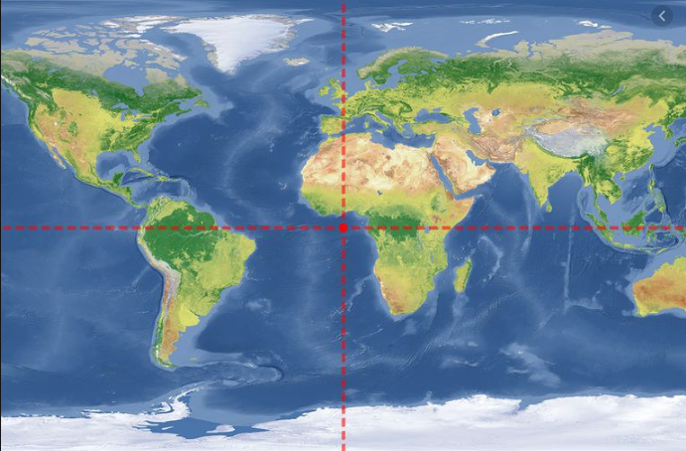
The coordinate system
A system that uses coordinates (x, y) to uniquely determine the position of the points or other geometric objects on a manifold (such as Euclidean space)
The (0, 0) coordinate, i.e. 0 degrees latitude and 0 degrees longitude
The point where the equator (0 degree latitude) and the prime meridian (0 degrees longitude) intersect.
Falls in the middle of a less known body of water (an area in the Gulf of Guinea)
Source: https://www.thoughtco.com/prime-meridian-and-the-equator-intersect-4070819

Slide 11

The coordinate system
A system that uses coordinates (x, y) to uniquely determine the position of the points or other geometric objects on a manifold (such as Euclidean space)
The (0, 0) coordinate, i.e. 0 degrees latitude and 0 degrees longitude
The point where the equator (0 degree latitude) and the prime meridian (0 degrees longitude) intersect.
Falls in the middle of a less known body of water (an area in the Gulf of Guinea)
Source: https://www.nsgic.org/null-island
Source: https://www.thoughtco.com/prime-meridian-and-the-equator-intersect-4070819
The null island

Slide 12
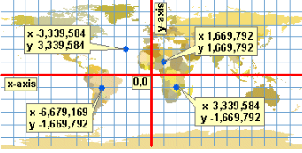
The coordinate system
A system that uses coordinates (x, y) to uniquely determine the position of the points or other geometric objects on a manifold (such as Euclidean space)
The (0, 0) coordinate, i.e. 0 degrees latitude and 0 degrees longitude
Source: http://www.geography.hunter.cuny.edu/~jochen/GTECH361/lectures/lecture04/concepts/06%20-%20Projected%20coordinate%20systems.html
Source: https://www.thoughtco.com/prime-meridian-and-the-equator-intersect-4070819

Slide 13
The coordinate system
A system that uses coordinates (x, y) to uniquely determine the position of the points or other geometric objects on a manifold (such as Euclidean space)
The (0, 0) coordinate, i.e. 0 degrees latitude and 0 degrees longitude
Source: http://www.geography.hunter.cuny.edu/~jochen/GTECH361/lectures/lecture04/concepts/06%20-%20Projected%20coordinate%20systems.html
Source: https://www.thoughtco.com/prime-meridian-and-the-equator-intersect-4070819

Slide 14
Geometric objects and Shapely module
The Shapely module in Python can be sed to create and manipulate geometric objects
Main geometric objects:
Point
LineString
Polygon

Slide 15
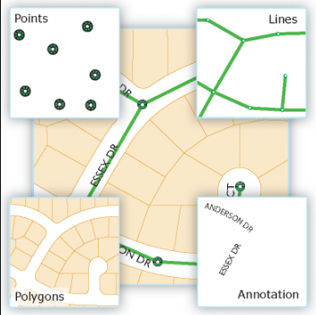
Geometric objects and Shapely module
Points represent a single point in space:
2D (lat, lon)
3D (lat, lon, alt)
LineString represent a sequence of points joined together to form a line
A list of at least two coordinate tuples
Polygon represents a filled area
A list of at least three coordinate tuples
Let’s see example in Python. Check it here.
Source: https://desktop.arcgis.com/en/arcmap/latest/manage-data/geodatabases/feature-class-basics.htm

Slide 16
Spatial data and Geopandas module
Read and write spatial data (shapefiles)
Create geometries into GeoDataFrame
Let’s see an example in Python. Check it here.

Slide 17
Geocoding
Geocoding = convert addresses into coordinate points (and viceversa).
Geocoding is very easy in Python using the geopy library
geopy uses third-party geocoders to locate an address (works with multiple providers)
Check here for more information on third-party geocoders:
https://automating-gis-processes.github.io/CSC18/lessons/L3/geocoding.html

Slide 18
Geocoding
To use the service of most third-party geocoders you will need to request an API access-key
However, Nominatim is API access key-free for small scale geocoding jobs
Nominatum is a geocoder based on OpenStreetMap data
We will work on a geocoding exercise by using Nominatum services. More precisely we will retrieve OpenStreetMap data using an address and the OSMnx module.

Slide 19
Geocoding
OpenStreetMap data is a collaborative project to create free editable map of the world containing plenty of information on streets, buildings, services, etc.
The OSMnx module can be used to retrieve, construct, analyze, and visualize street networks from OpenStreetMap
Let’s look at this example.

Slide 20
References
The Coordinate System:
https://en.wikipedia.org/wiki/Coordinate_system
GIS with Python:
https://automating-gis-processes.github.io/CSC18/course-info/course-info.html

